Slide 1
LO: To retell the Judeo-Christian creation story

Slide 2
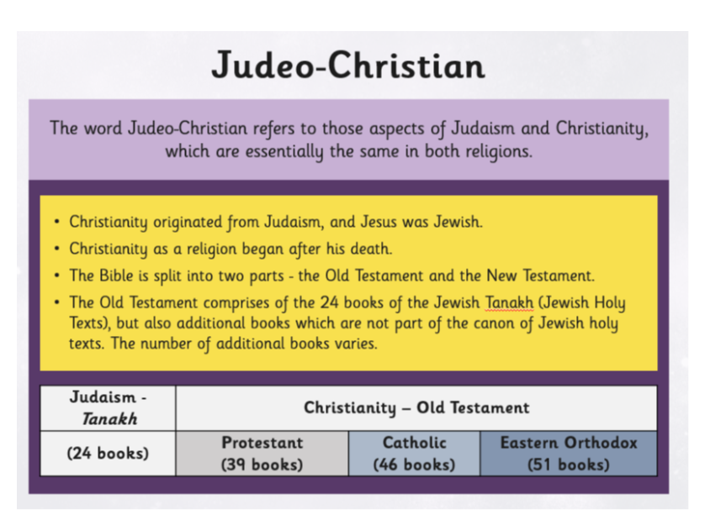

Slide 3
What are the important books called in Judaism and Christianity?
This is where we will get their stories from

Slide 4
https://www.youtube.com/watch?v=ak06MSETeo4

Slide 5


