Slide 1
Monday

Slide 2
LO: To investigate the structure of a story

Slide 3

https://www.youtube.com/watch?v=B_TfA7pOoS4
While you listen complete
the Puzzles and Patterns sheet.

Slide 4
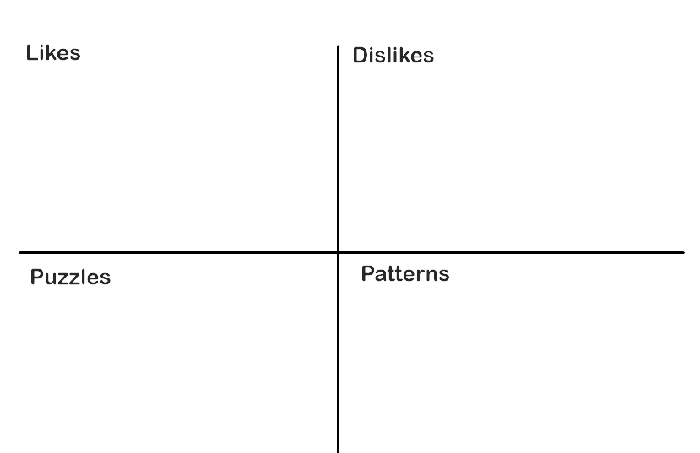
Fill in this sheet with what you like, don’t like, what confuses you and what patterns you notice from the story.

Slide 5
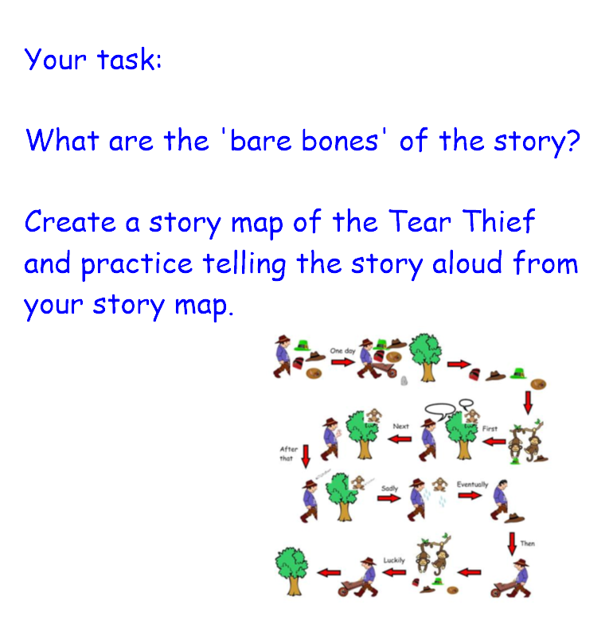

Slide 6
Tuesday

Slide 7
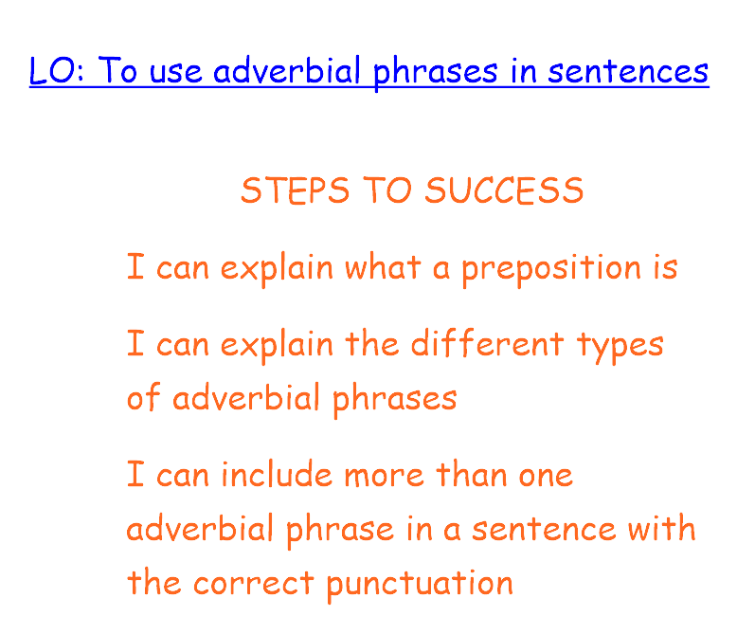

Slide 8
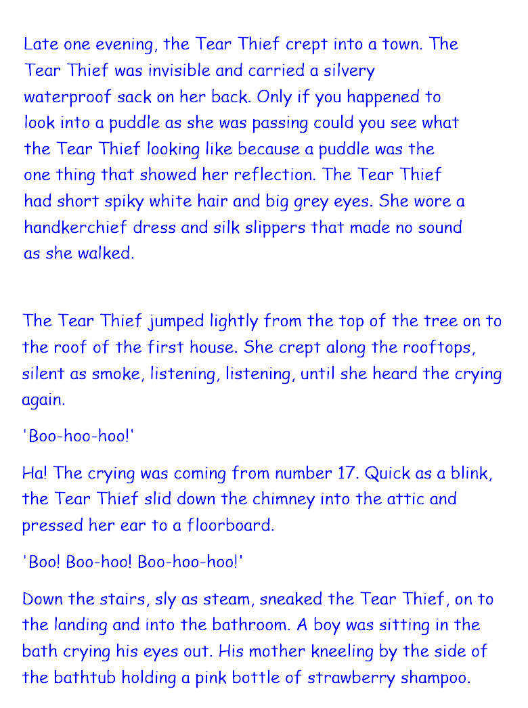

Slide 9
Please research what an adverbial phrase is.
Go through the text on the previous slide and find as many adverbial phrases as you can.
Can you sort them into the three types of adverbial phrase?

Slide 10
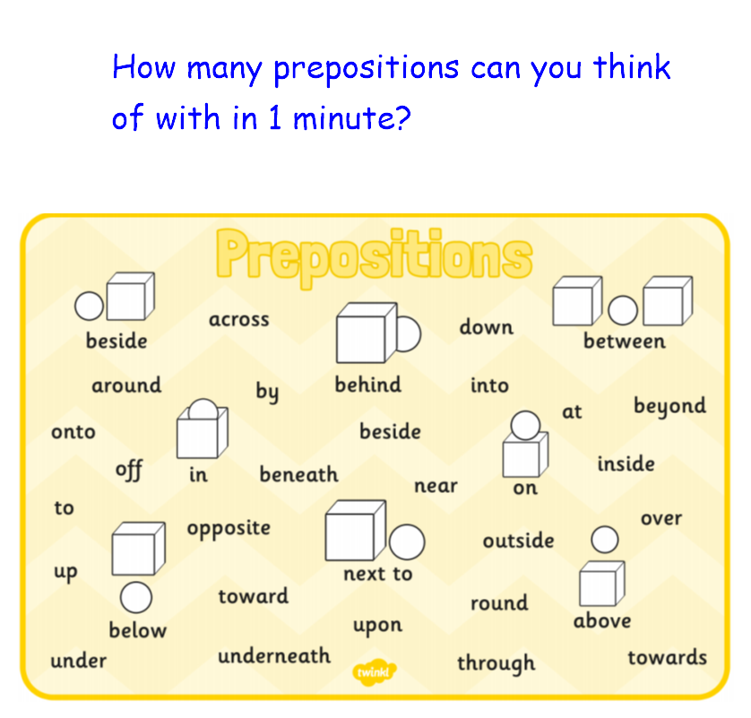

Slide 11
Can you describe a journey you make around the school using prepositions?

Slide 12
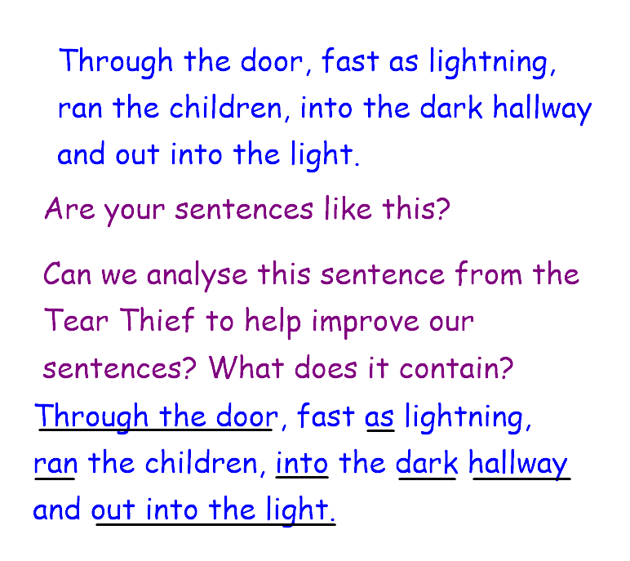

Slide 13
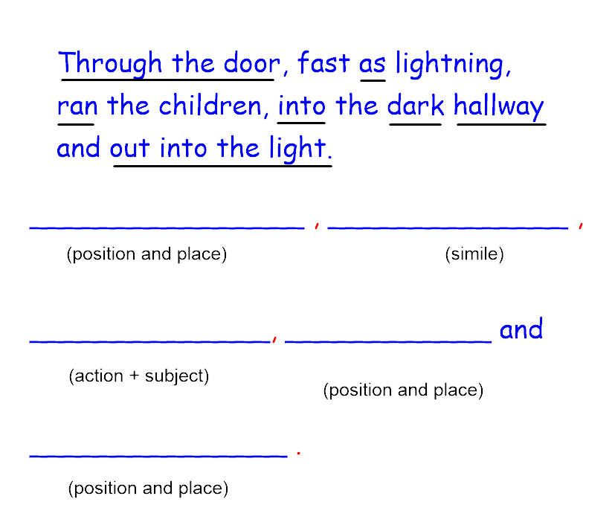

Slide 14
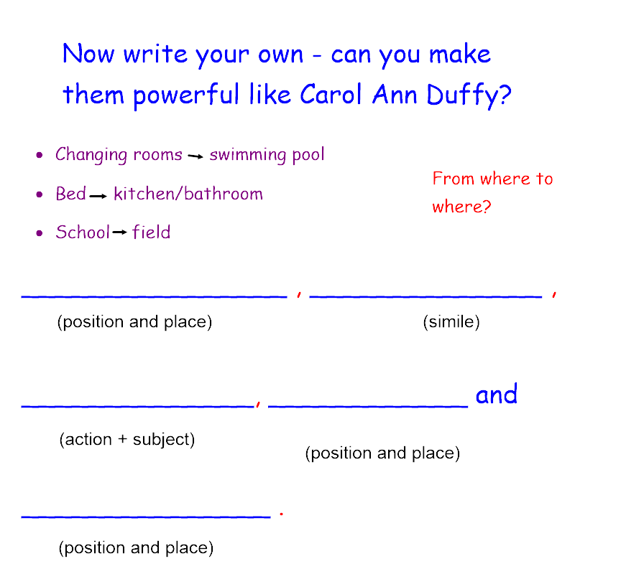

Slide 15
What is the effect of this type of sentence?

Slide 16
Wednesday

Slide 17
LO: To be able to use quality similes and metaphors

Slide 18
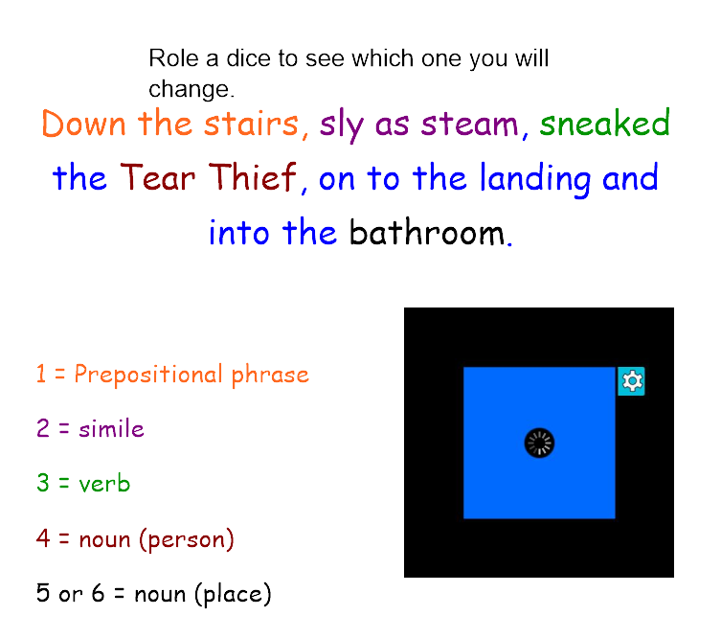

Slide 19
Listen to the story read by carol Ann Duffy twice.
How many similes and metaphors can you hear?
Write a list .
Support - listen carefully and finish the similes on the sheet.
https://www.youtube.com/watch?v=B_TfA7pOoS4

Slide 20
Which simile/metaphor is your favourite? Why do you like it?

Slide 21
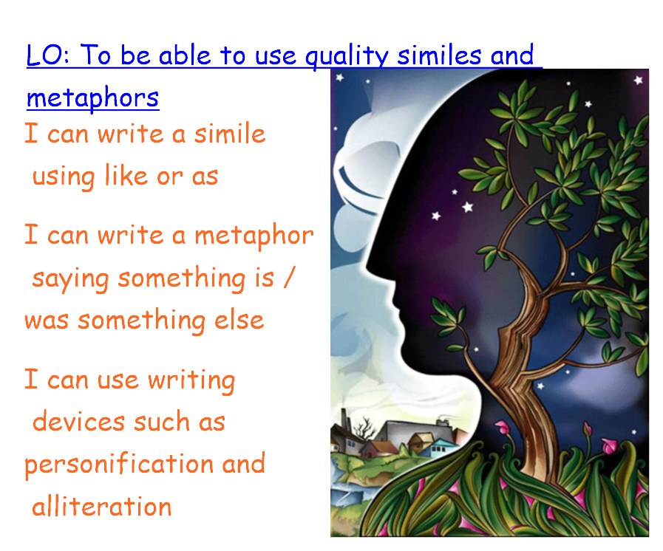

Slide 22
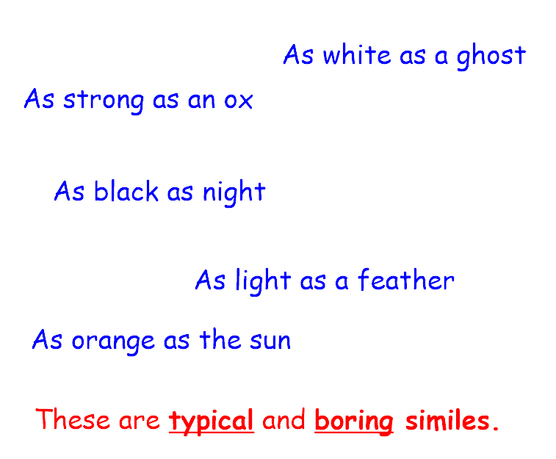

Slide 23
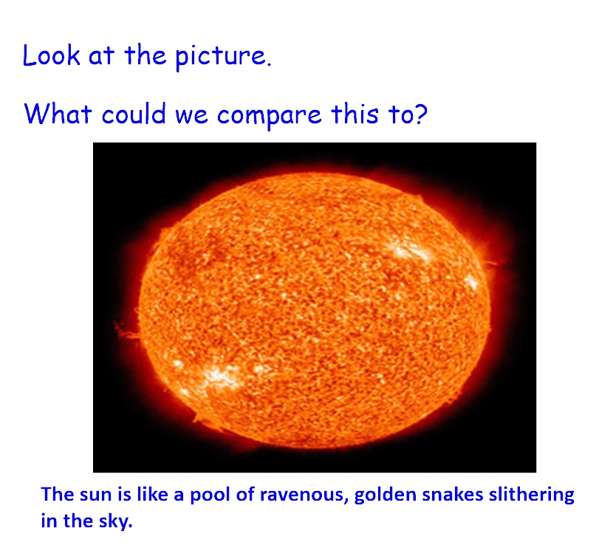

Slide 24
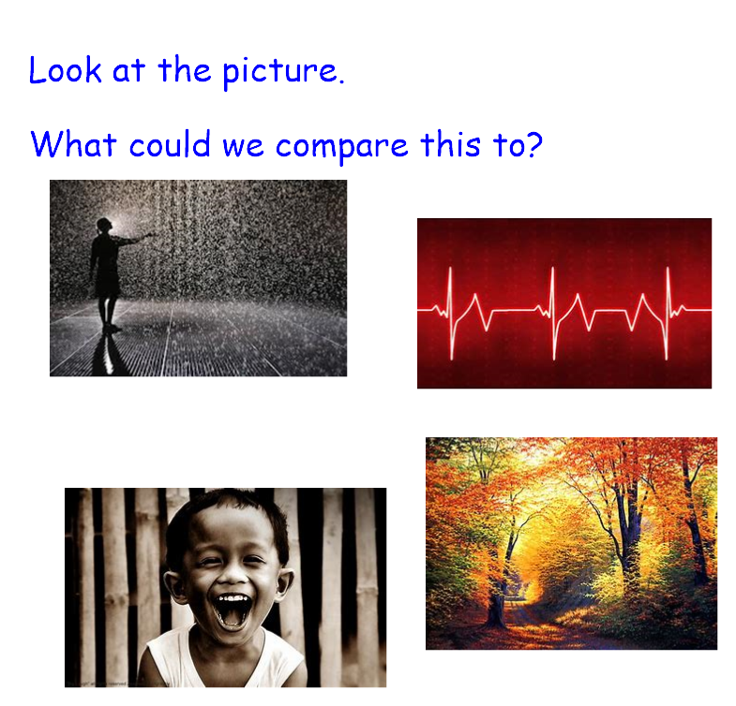

Slide 25
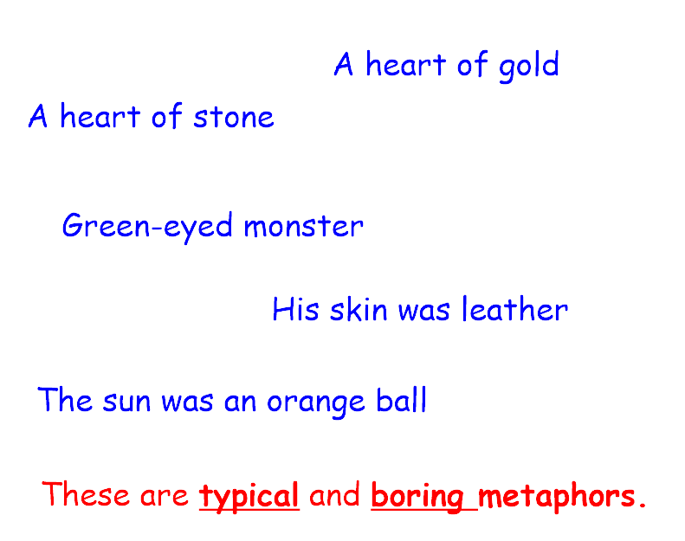

Slide 26
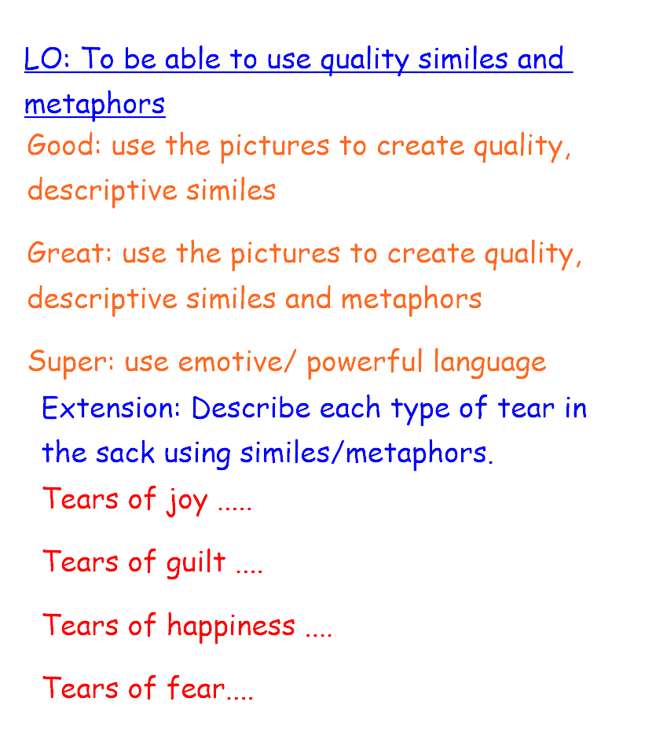

Slide 27
Thursday

Slide 28
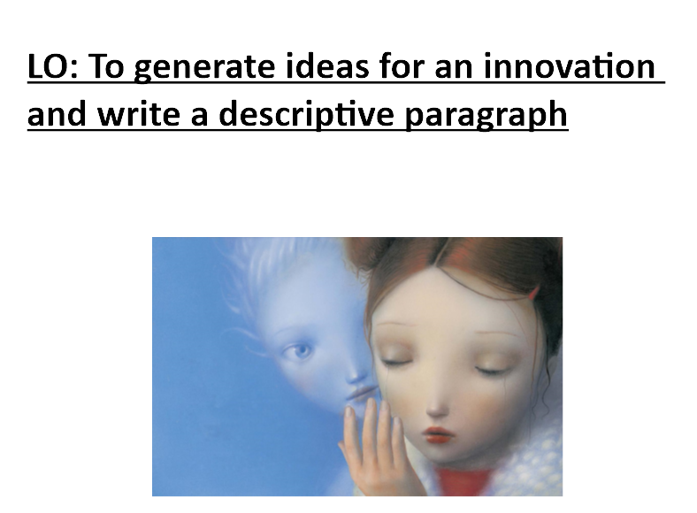

Slide 29
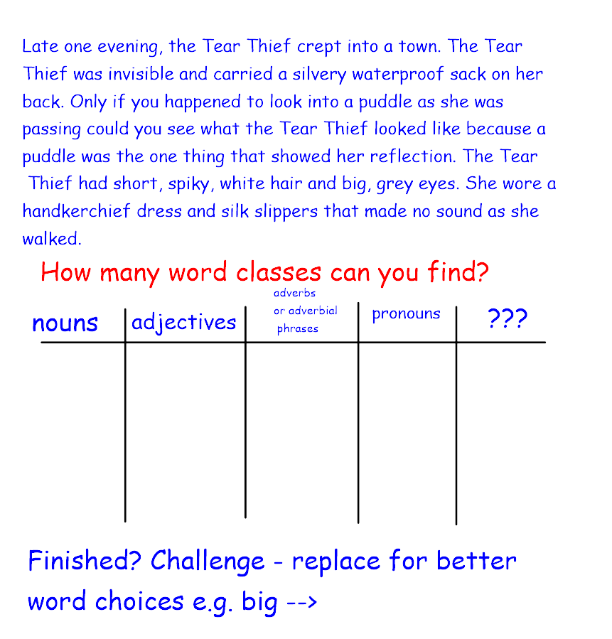

Slide 30
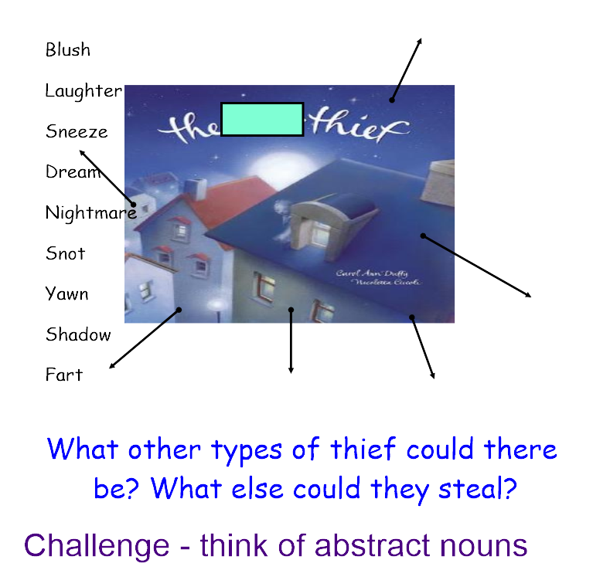

Slide 31
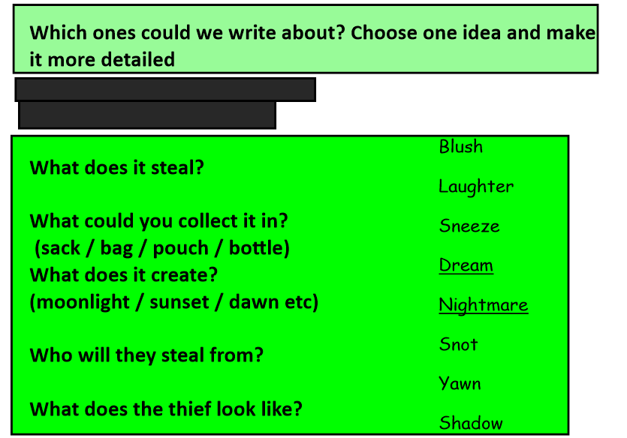

Slide 32
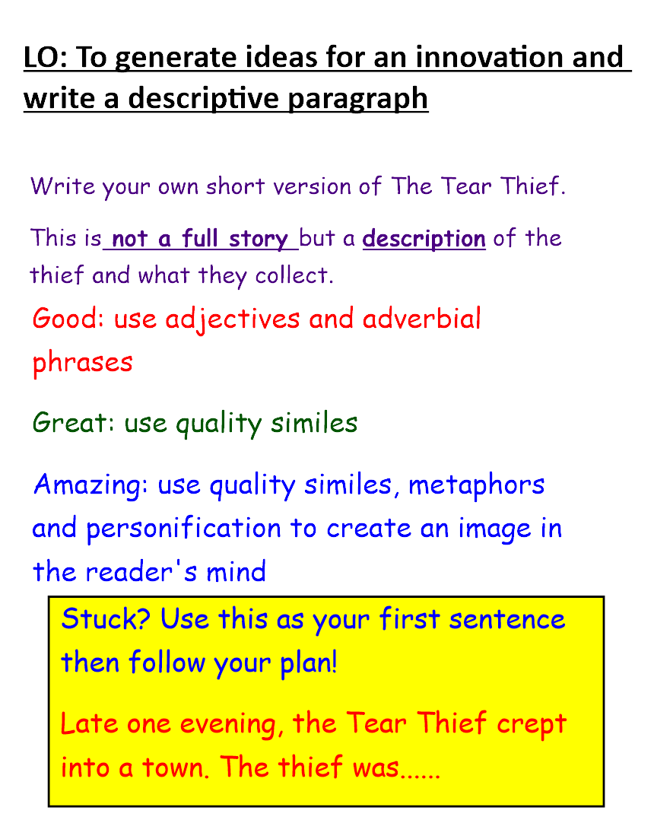
Use the following three slides to guide your writing

Slide 33
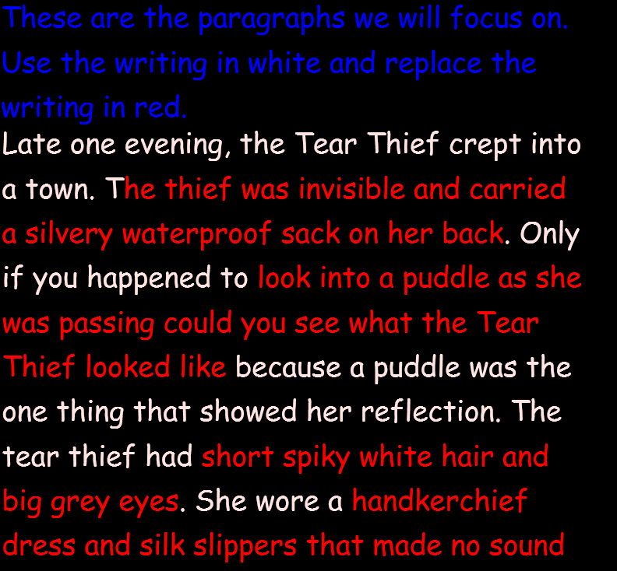
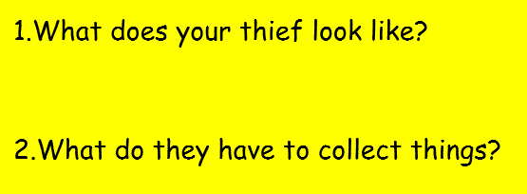

Slide 34
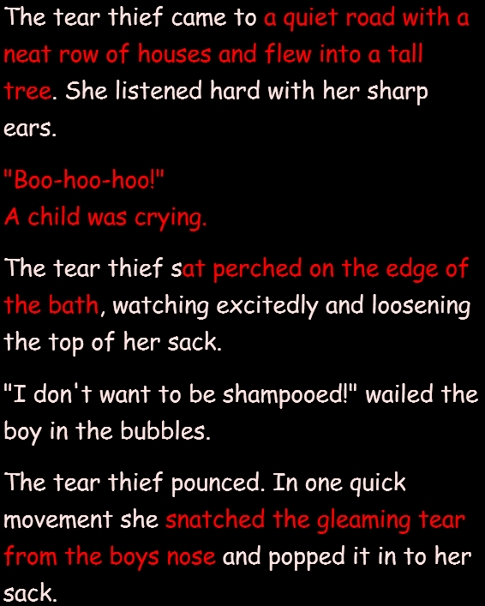
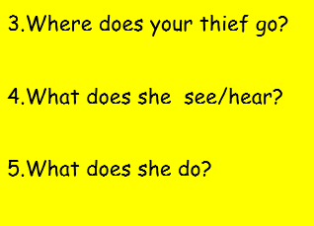

Slide 35
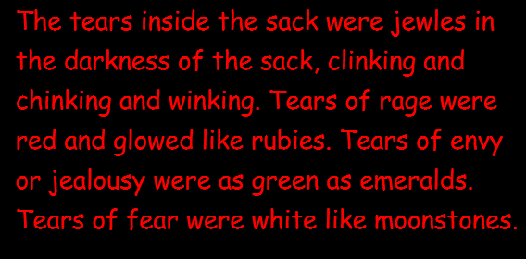
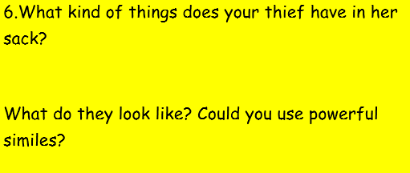

Slide 36
Friday

Slide 37
LO: To edit and improve my writing

