Slide 1



TERMS OF USE
This resource is copyright ©ELSA Support
All free products on this site are subject to a Creative Commons copyright licence. You are free to copy, distribute, display, and perform the work under the following conditions:
Attribution: You must give the original author credit (That is ©ELSA Support)
Non-Commercial: You may not use this work for commercial purposes (You cannot sell this work or use it for financial gain)
No Derivative Works: You may not alter, transform, or build upon this work (You must not change our work in anyway)
Thank you for abiding by copyright law.
www.elsa-support.co.uk

Slide 2
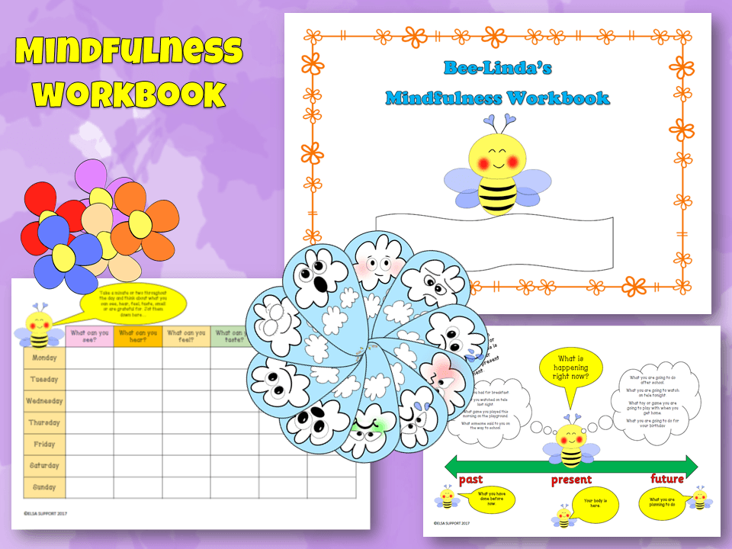
Other resources you will LOVE!
Please click the image to take you to this related and relevant resource:
www.elsa-support.co.uk

Slide 3



Slide 4
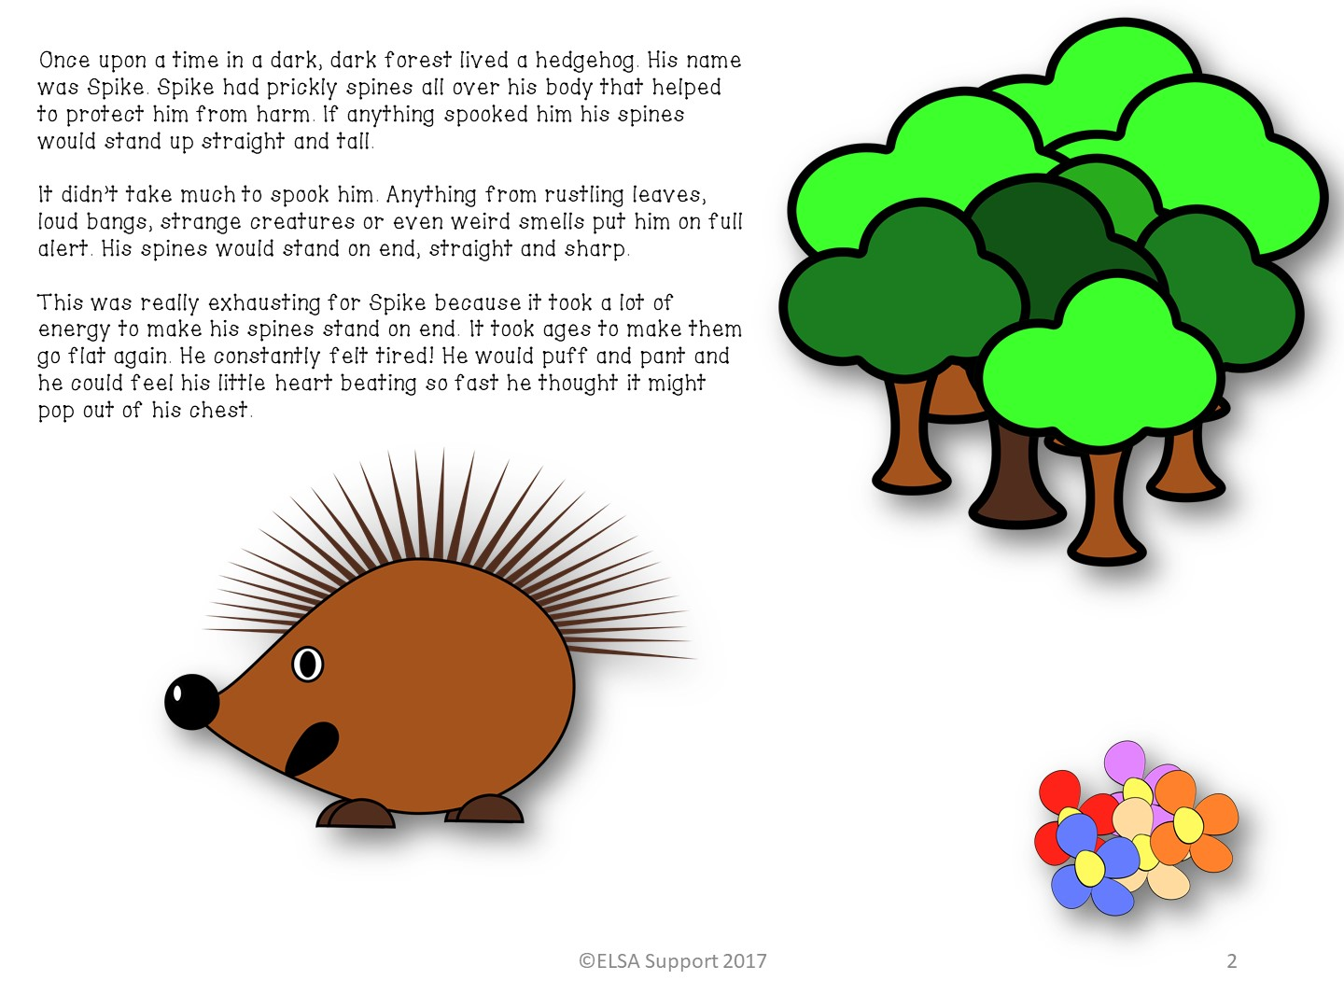

Slide 5
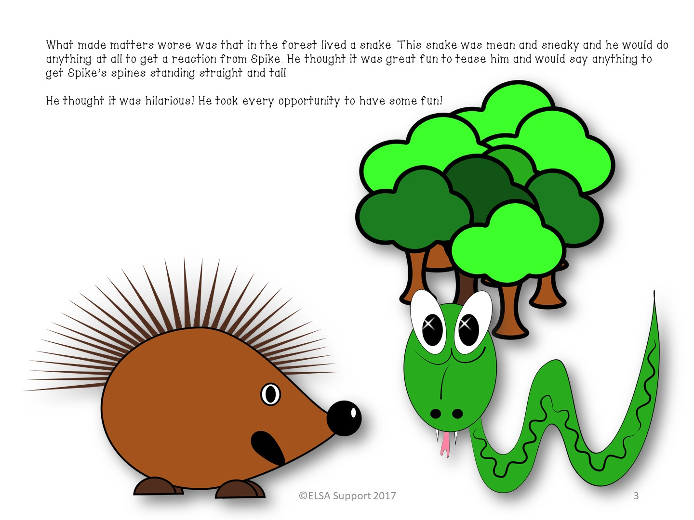

Slide 6
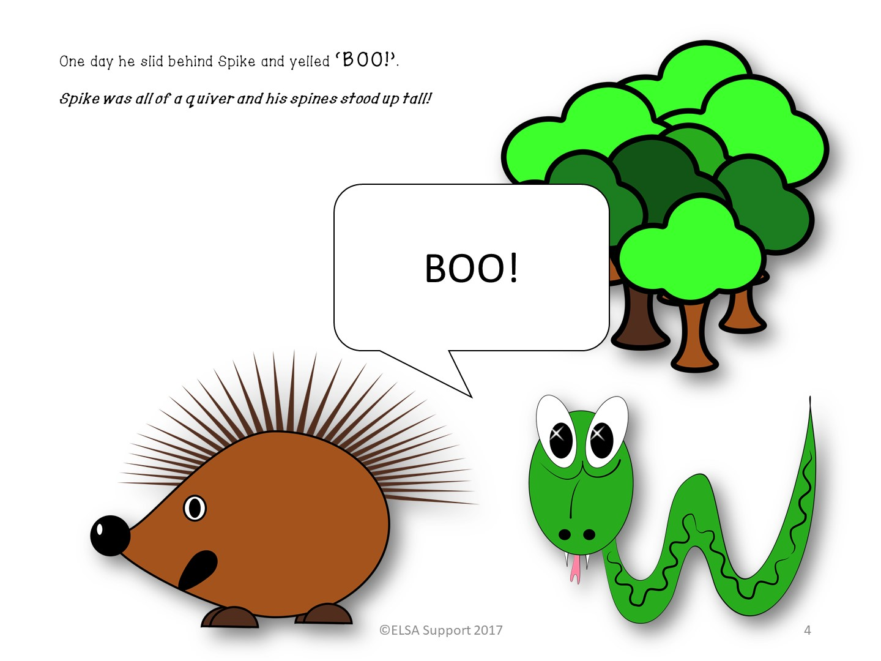

Slide 7
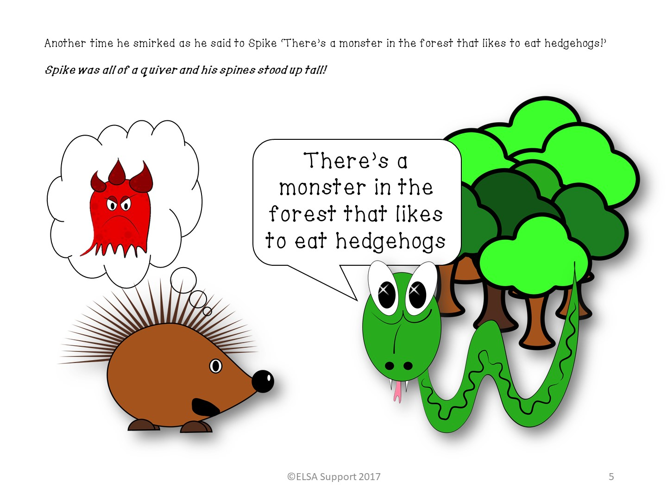

Slide 8
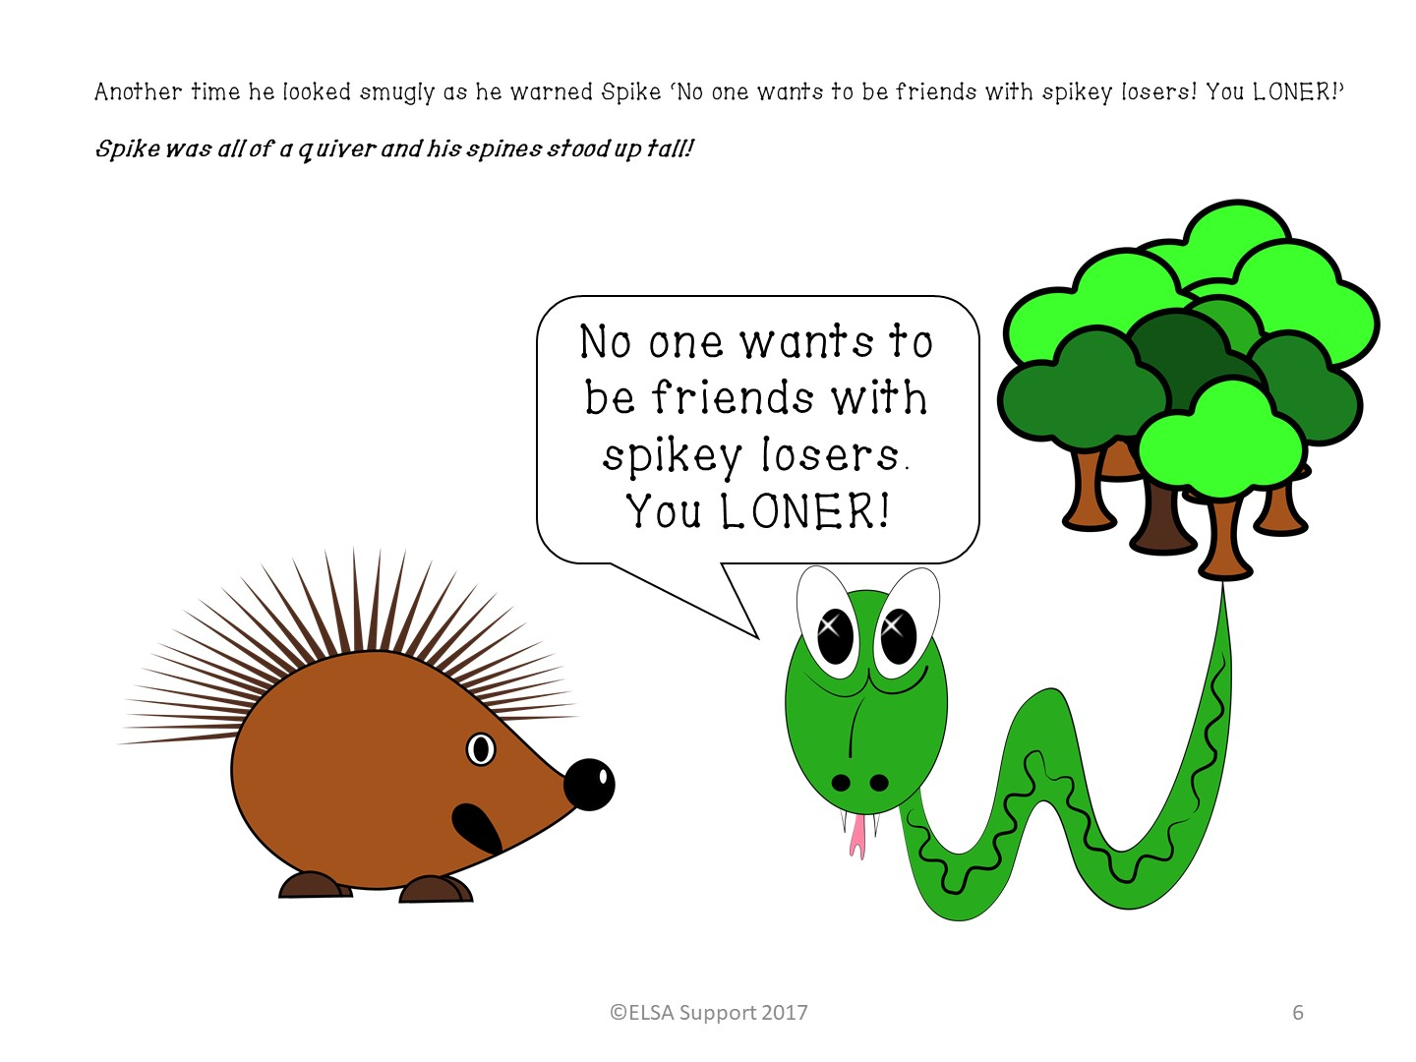

Slide 9
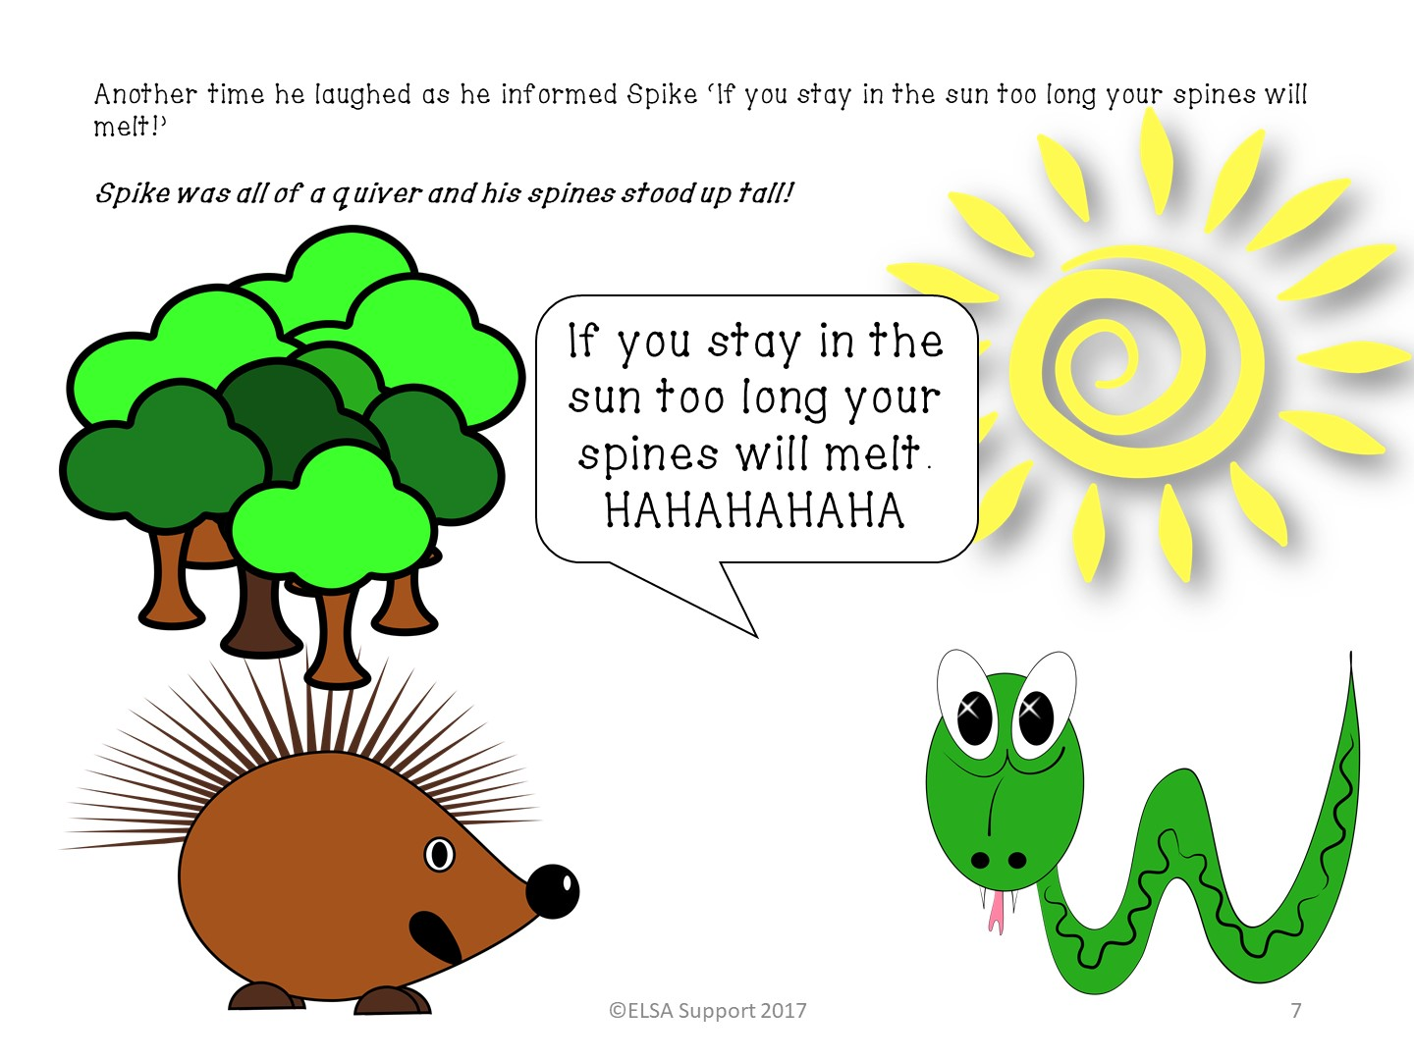

Slide 10
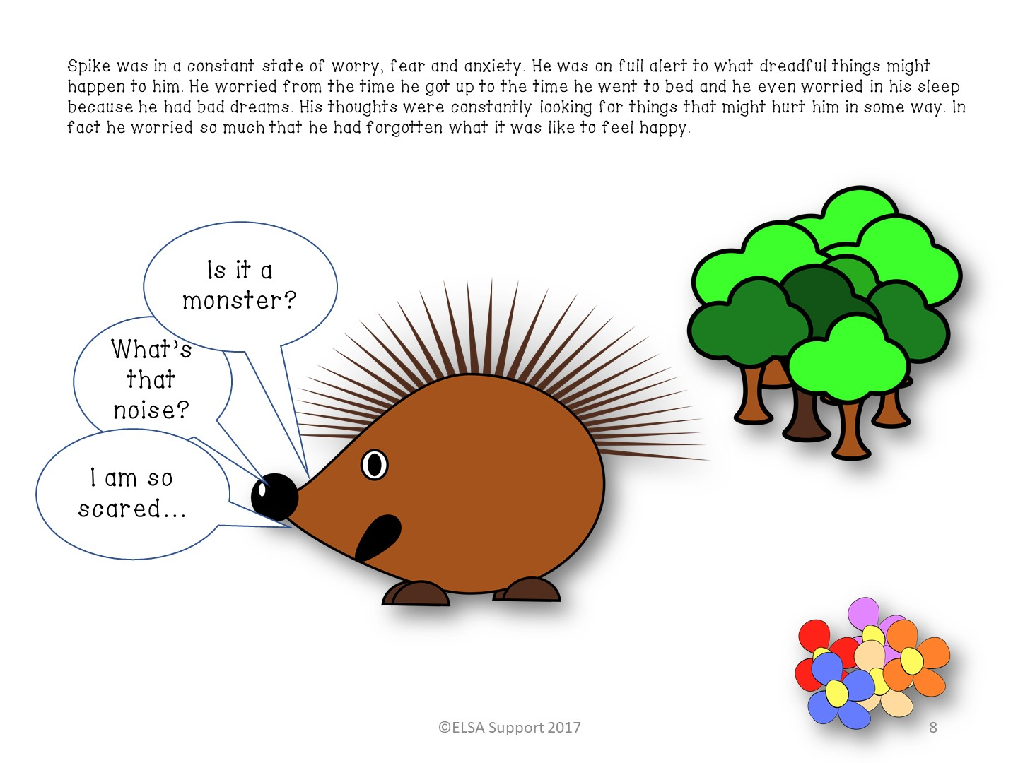

Slide 11
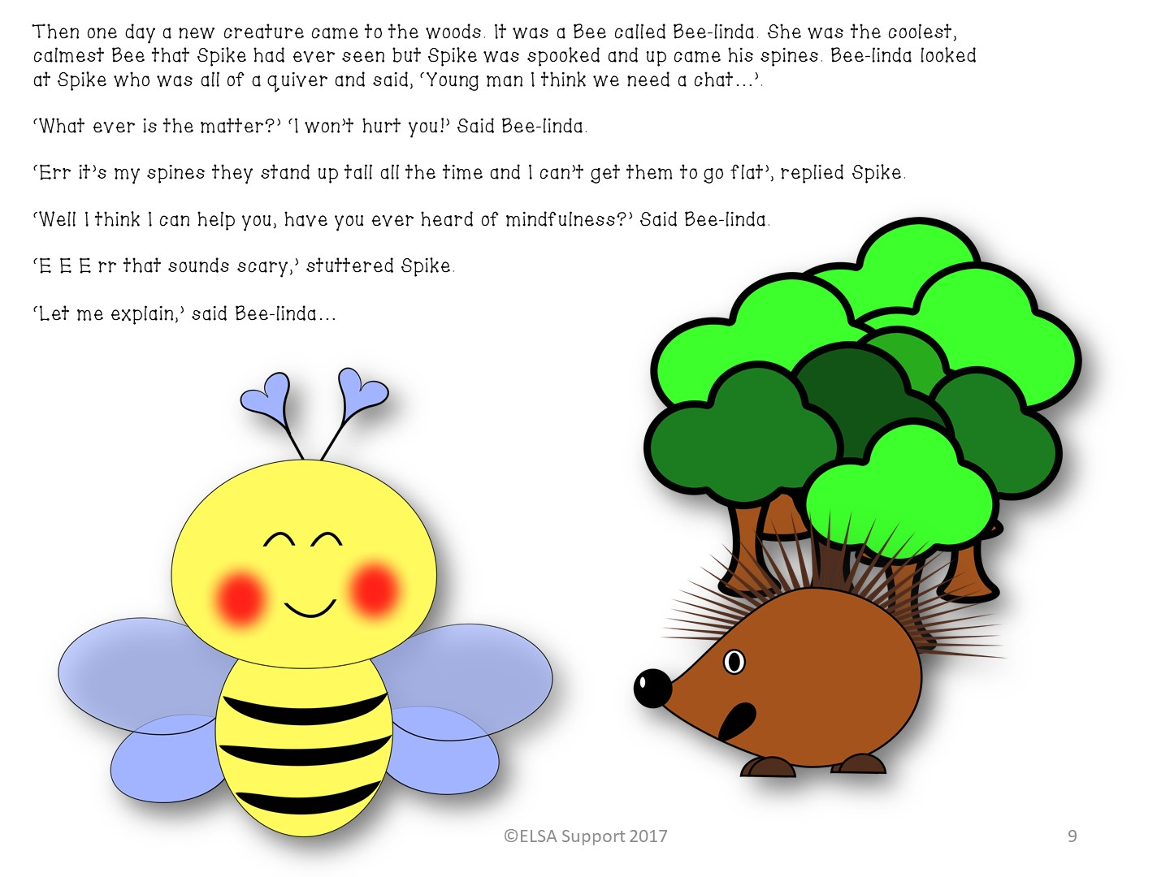

Slide 12
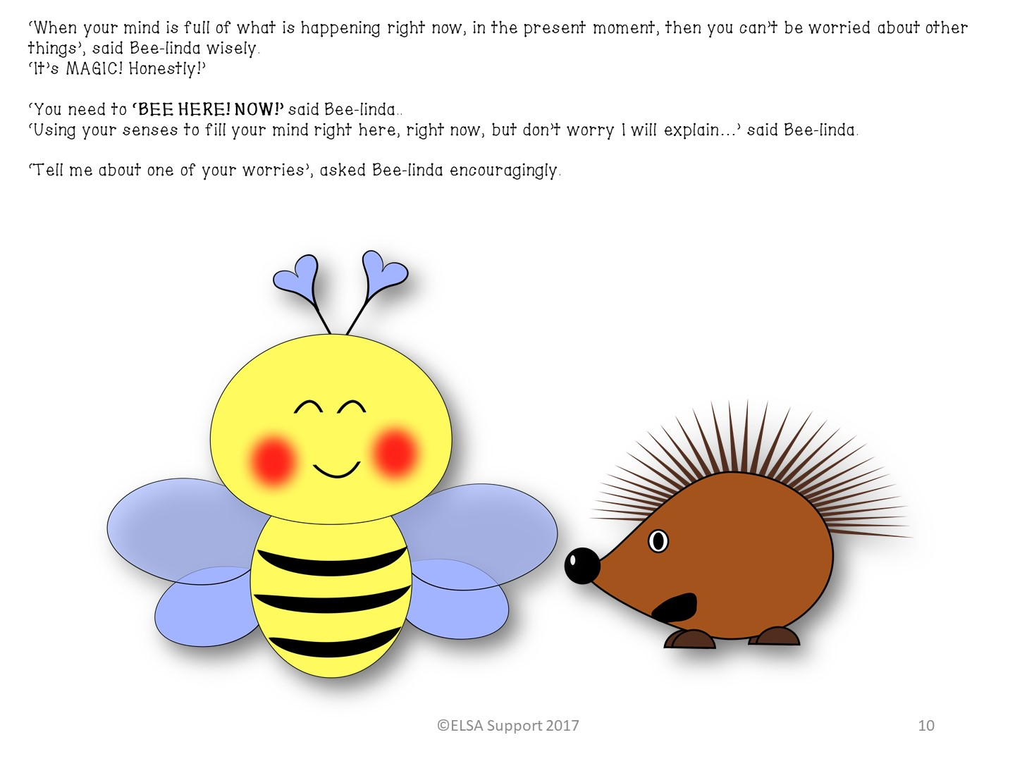

Slide 13
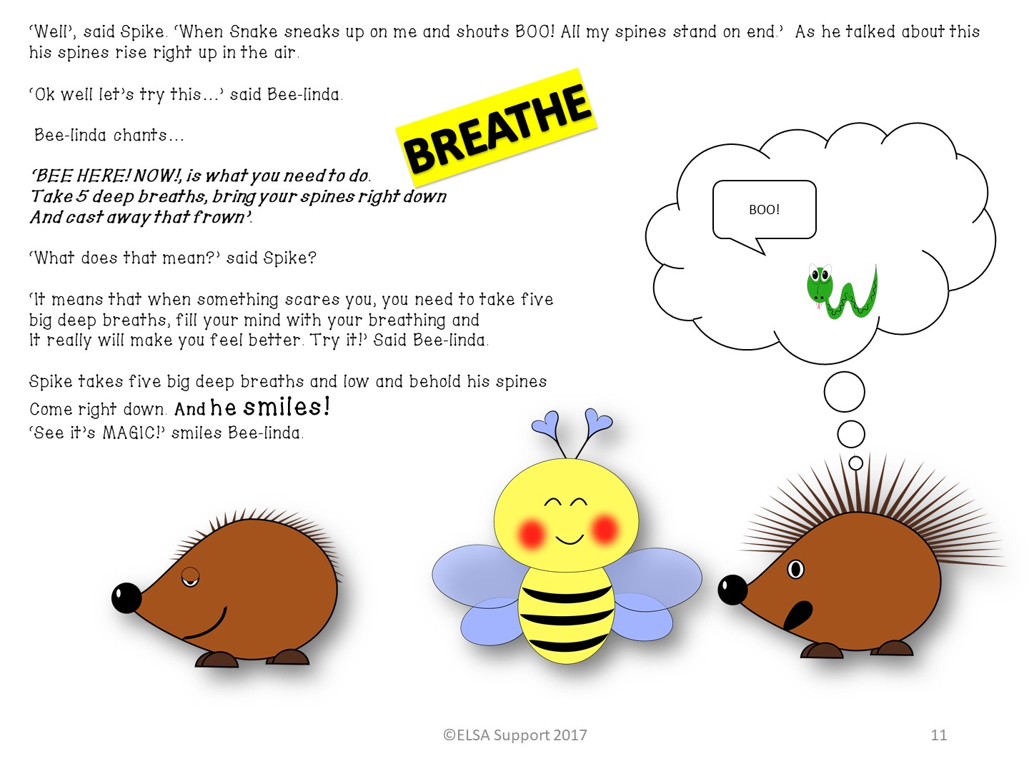

Slide 14
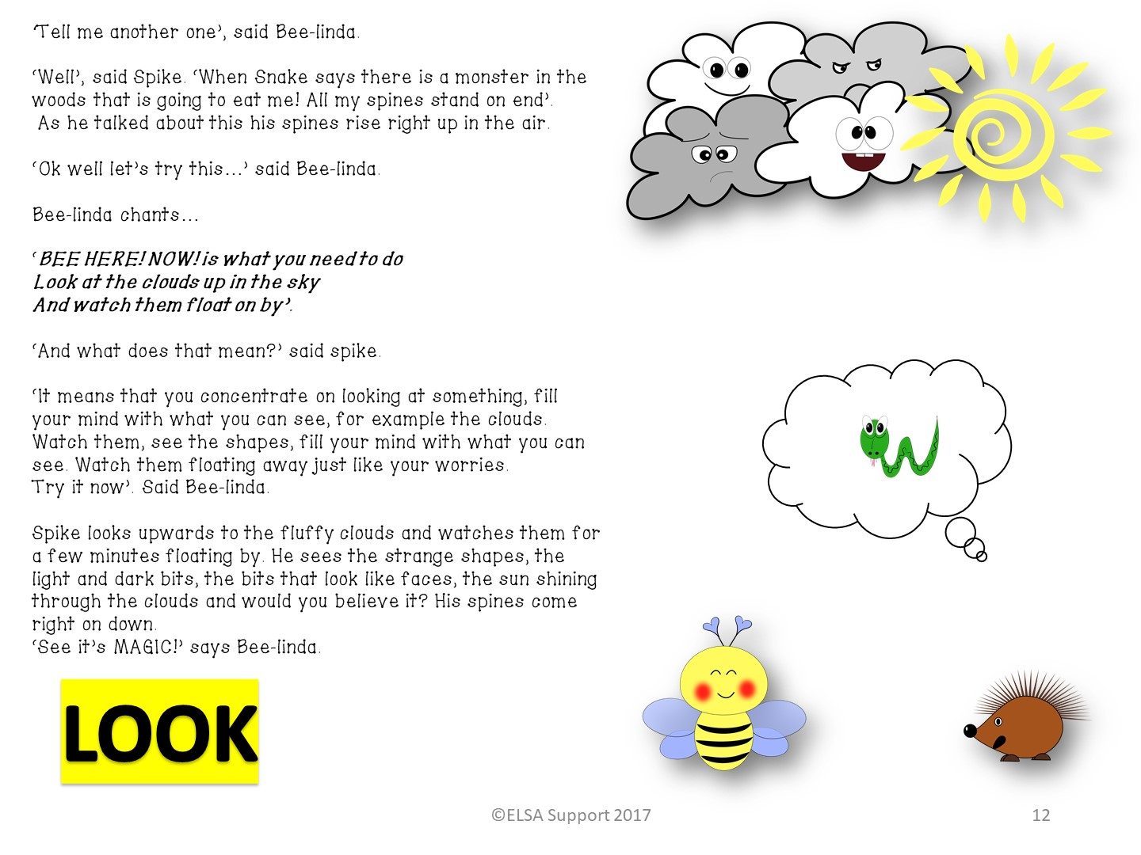

Slide 15
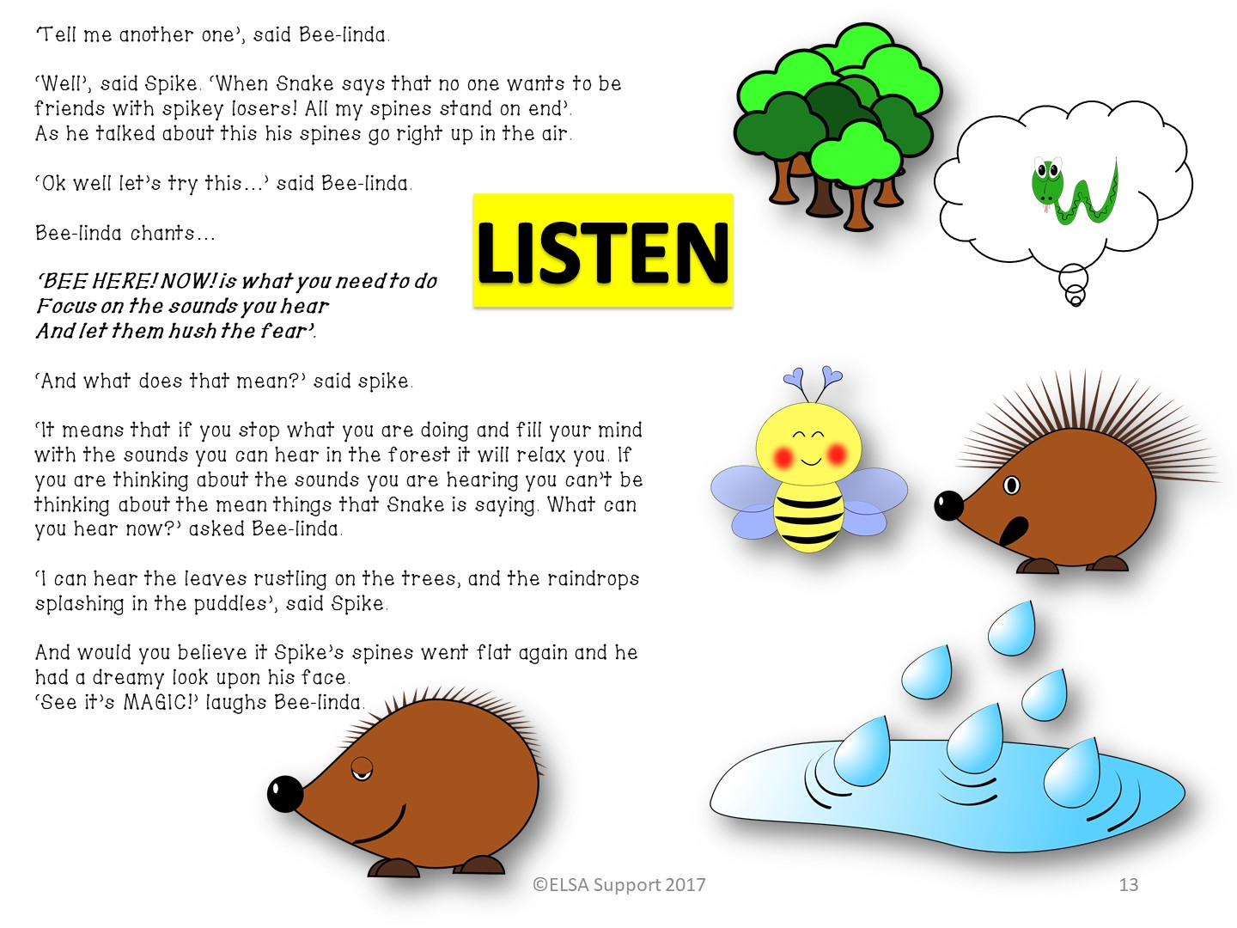

Slide 16
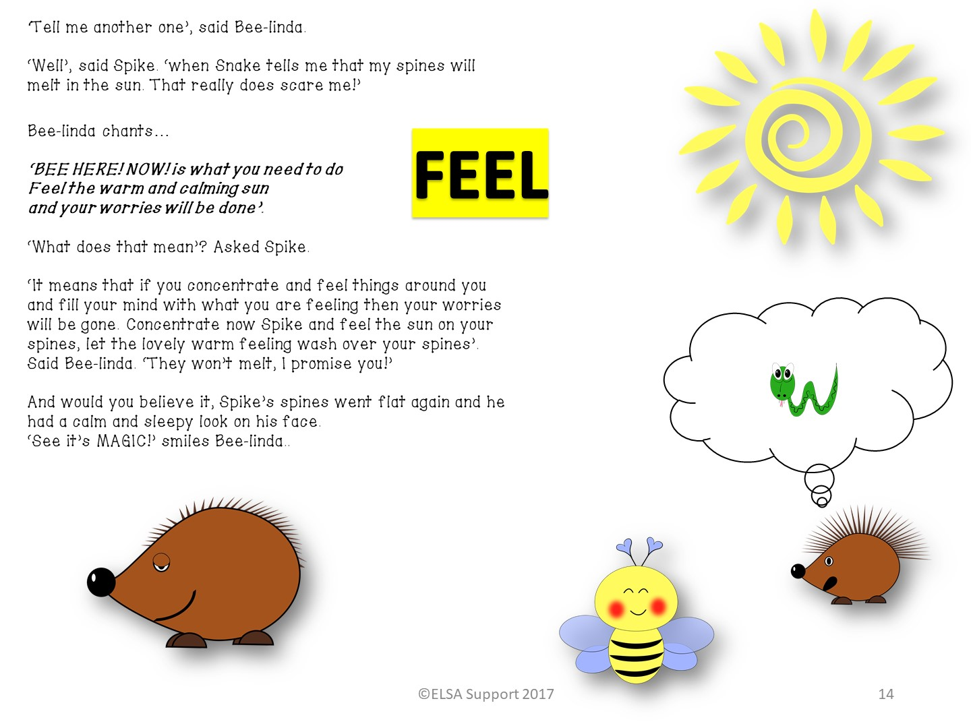

Slide 17


